Slide 1


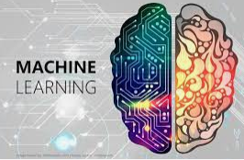
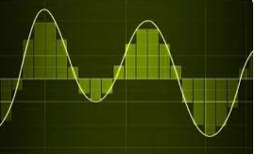
GA Tech Capstone Analytics Practicum Proposal A partnership with Sandia National Laboratories
Presented By: Stephen Smith Data Analyst & GA Tech MSCS Graduate 2020
Proposal Topic
Machine Learning/Computer Vision Applied to Signal Analysis
to automatically predict signal degradation

Slide 2
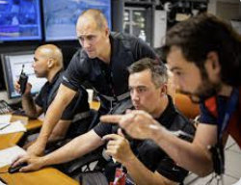
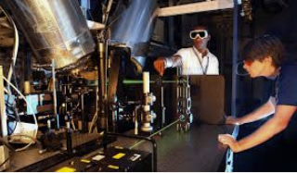

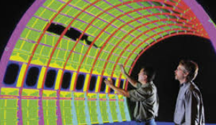
Who We Are and What We Do
Sandia National Laboratories creates and fosters an environment where some of the most talented engineering and computer science professionals form teams to solve some of the nation’s most challenging engineering programs. Our national laboratory been solving the most difficult technical challenges for over 75 years, serving in the national interest.
A team of Sandia engineers and computer scientists met to propose a challenging technical Capstone Analytics Practicum project containing several real-world applications

Slide 3
Background for Proposal Idea
As hardware components age over time, the critical signals those components generate can change
Physically testing critical components is expensive and time-consuming
We would like to introduce you to an innovative way components could be tested automatically by checking the signal outputs they produce and comparing them to a dataset of “healthy” signals by using Machine Learning and/or Computer Vision

Slide 4
General Proposed Machine Learning Process
Collect a dataset of degraded signals and signals that have not degraded
Extract relevant information from those signals that help identify the degradation (this could include statistical measurements like mean, variance, and skewness
Split the dataset into training, validation and testing sets
Train the model
Evaluate the model
Use the model

Slide 5
Finding or Creating Data
You have the freedom to identify an existing dataset to study. Note: Several students in Spring, 2024 semester used a hybrid combination of synthetic AND existing data
Some students created synthetic data of their own. In the previous semester, I encouraged this route, but found many students located already existing datasets and that was an easier approach
You are welcome to explore either option. If you want more information about creating synthetic data sets, I can talk to that through DM in Slack or during an office hour session

Slide 6
Previous Semester Methodologies Used
Random Forest
XG Boost
Logistic Regression
K-Nearest Neighbors
Decision Tree
LightGBM (LGBM)
GBM
Linear and/or Non-Linear SVM
Naïve Bayes Classifier
Gaussian and Bernoulli Kernels
Montecarlo Simulations

Slide 7
General Proposed Computer Vision Process
Data Pre-processing: Clean and preprocess the data to ensure it is ready for model training. This includes handling missing values, removing noise, scaling features, and converting data into a suitable format for machine learning algorithms.
Feature Engineering: Extract relevant features from the preprocessed data that can be used to train the model. This step involves selecting appropriate features that capture the most important aspects of the data.
Model Selection and Training: Choose a suitable deep learning model for anomaly detection, such as convolutional neural networks (CNNs), auto-encoders, or other unsupervised learning techniques. Train the model using the extracted features and the preprocessed data.
Model Evaluation: Assess the performance of the trained model using a validation dataset. This step involves evaluating the model's accuracy, precision, recall, and other relevant metrics.
Threshold Selection: Determine the appropriate threshold for anomaly detection. This threshold separates normal instances from anomalies based on the model's output.
Model Deployment: Integrate the trained model into the production system and monitor its performance over time. This step involves deploying the model into the desired environment and ensuring its continued accuracy and reliability.

Slide 8

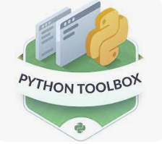





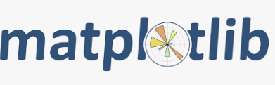
Using Python and Toolboxes to Work Toward a Solution
Scikit-learn
Tensor Flow
PyTorch
Keras
NumPy & Pandas
Matplotlib & Seaborn
Sci-kit Image
Open CV
Torch Vision

Slide 9
Good Lessons Learned from Spring, 2024
Spend time cleaning and wrangling the data so it is in a format you can analyze
Consider leveraging available datasets used in studies you find through Google Scholar
Begin thinking about how you can improve upon an existing study or take your study in a new direction based but use the same dataset
Don’t limit your imagination. This project has many applications and previous semester students made liberal interpretations of signal data

Slide 10
Computer Vision Study
You can perform signal analysis by training up a computer vision model (or several for that matter)
You can utilize both computer vision and machine learning as part of your project.
Publicly available image databases do exist if you go this route, so the data acquisition search is similar to the machine learning route

Slide 11
Widely Used Computer Vision Tools
The most common Python libraries used for computer vision include:
OpenCV: An open-source computer vision library with over 2500 optimized image and video processing algorithms. It supports various functions for image and video processing, object detection, image classification, and more.
TensorFlow: Developed by Google, TensorFlow is an open-source platform for implementing machine learning and deep learning models. It offers a JavaScript library (TensorFlow.js) for training and deploying models in browsers, and supports deployment on mobile and embedded devices.
Simple CV: A computer vision framework that simplifies image acquisition and processing tasks. It is known for its ease of use and compatibility with a wide range of input sources, including the Microsoft Kinect.
Scikit-Image: A scientific approach to computer vision that provides utilities for transforming images geometrically and adjusting their contents. It is an extension of Scikit-Learn and can be used for image processing and operating natively with NumPy arrays as image objects.
Pillow (PIL Fork): An open-source library for the Python programming language that provides image processing capabilities. It can be used with Windows, Mac OS X, and Linux and supports reading and saving images of different formats.
Torch Vision: An extension of PyTorch, TorchVision contains common image transformations for computer vision tasks, as well as datasets and model architectures for neural networks.

Slide 12
Backup Slide – Full Description of the Process
Collect and preprocess the data: Collect a dataset of signals that have degraded and a dataset of signals that have not degraded. Preprocess the data by cleaning, normalizing, and transforming it into a format suitable for machine learning.
Feature extraction: Extract relevant features from the signals that can help identify degradation. These features could include statistical measures such as mean, variance, and skewness, as well as spectral features such as frequency components or spectral power.
Split the data: Split the dataset into training, validation, and testing sets. The training set is used to train the machine learning model, the validation set is used to tune hyperparameters, and the testing set is used to evaluate the model's performance.
Train the model: Train a machine learning model using the training set. The model should take the extracted features as input and output a prediction of whether the signal has degraded or not.
Evaluate the model: Evaluate the performance of the model using the validation and testing sets. Metrics such as accuracy, precision, recall, and F1-score can be used to assess the model's performance.
Use the model: Once the model has been trained and evaluated, it can be used to make predictions on new signals. If the model predicts that a signal has degraded, it may be necessary to take corrective action to restore the signal's quality.

Slide 13
Backup Slide – Python Toolbox Descriptions
scikit-learn: This is a widely used Python library for machine learning that provides a wide range of algorithms for classification, regression, clustering, and other tasks. It also includes tools for model selection, data preprocessing, and feature engineering.
TensorFlow: This is a popular open-source machine learning library developed by Google. It allows users to define, train, and run machine learning models using Python. TensorFlow provides a wide range of tools for building and training neural networks, as well as tools for working with large datasets.
PyTorch: This is another popular open-source machine learning library that provides a dynamic computation graph and allows for more flexible model architecture. It is particularly useful for rapid prototyping and development of complex models.
Keras: This is a high-level neural networks API that can run on top of TensorFlow, Theano, or PyTorch. It allows users to quickly build and experiment with neural network models using Python.
NumPy and Pandas: These libraries provide powerful tools for data manipulation and analysis, and are often used as a foundation for machine learning analysis. NumPy provides support for large, multi-dimensional arrays and matrices, while Pandas provides data structures and functions for working with tabular data.
Matplotlib and Seaborn: These libraries provide popular visualization tools for data analysis and machine learning. Matplotlib provides a wide range of visualization options, while Seaborn provides a high-level interface for creating informative and attractive visualizations.

